Slide 1

Multi-Channel Optimal Path Sequencing
Bayesian Deep Learning
Vish Hawa
Principal Scientist, Vanguard
ODSC : Data-Science Workshop
https://github.com/vishalhawa/odsc
vishal_hawa@vanguard.com
April, 2020
Notes:
Test results
Math - loss functions
Vector interpolation – next best action
Optimal path from a positon
Bayes info and prior

Slide 2
BUSINESS CONTEXT
Marketing leads are exposed numerous channels, and it creates complex cross-channel relationship that makes campaign difficult to execute
It is difficult to isolate how much credit should be attributed towards each channel. This can have big impact on how much budget /efforts should be put into any particular channel
Are there sequences that are better at driving leads than others? Build model and Conduct Path Analysis and Produce weights to channel contribution for each path
RNNs have shown great promises on sequence-modelling ( but can we solve memorizing shortcomings especially when data size is limited)

Slide 3


SEQUENCE COMBINATIONS
Touch-Points
Touch-Points
Touch-Points
ADV
WEB
WEB
ADV
EMAL
SR
A
MAIL
WEB
PHONE
ADV
WEB
SR
B
Marketing Channels
MAIL
PHONE
PHONE
ADV
WEB
ADV
C
Touch Point Facts
Touches range from 1 – 100+ , median 15 touches
Possible space: 7¹⁵ ~ 5T Paths! (ordered sequence)
Even sequence length of 10 ~ 300M paths!
Very sparse evidence (~ typically 1M observations)

Slide 4
RNN AS SEQUENCE MODELER
Points - of Discontinuities
“Modeling of Symptoms ”
Touch-Points
Extremities
Prominent when data size is small compared to possibilities
More skewed the strength of evidence - higher the discontinuity
Higher dropout rate helps – may not solve it
True features (z) are latent unobservable
can we do better ?
Notes:
L2 normalization – check

Slide 5
RNN AS SEQUENCE MODELER
Stacking : 2 –layers
Seq. Length: 5
Dense: 2-layer with classifier
Optimizer: RMSprop
Loss: binary-cross-entropy
IN: 3-dim embedding of channels
Dropout = 0.2
Increase of
~ 2 folds !!
Ch_1_1_2_1_6
47%
Ch_1_1_2_5_6
99%
Ch_1_1_2_0_6
0%
Drops to ~0%

Slide 6
WHAT’S CAUSING IT…
Data is not incorrect but incomplete ~ any inferences will be incomplete
We have been modeling symptoms and not true features
Longer the sequence – the worse it gets
Higher the number of channels - the worse it gets
Can it improve over time with more data? – Yes but that may take long time and the world would have moved on..
What's my confidence in the results – its hard to obtain if modeled directly
Can I get the most promising sequence or a set to begin with?
How about Next Best Actions ? – may not as we are modeling symptoms !

Slide 7
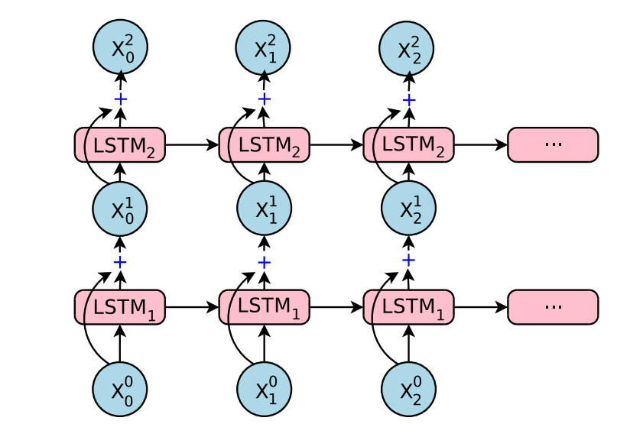
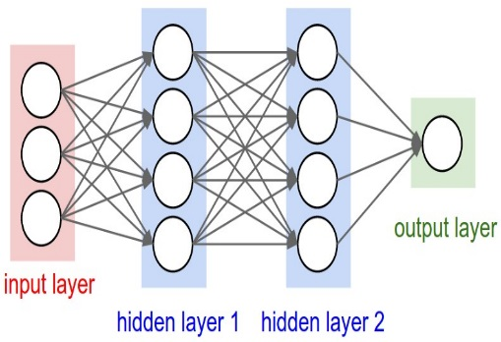
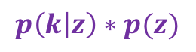
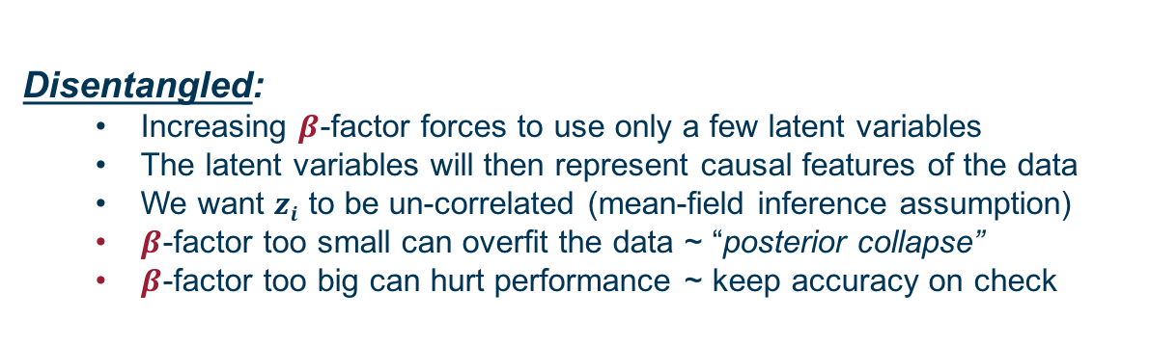
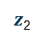
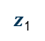
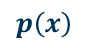
ARCHITECTURE: DISENTAGLED VARIATIONAL ENCODER
Latent
Space
(z)
sampled
$z$₁
Dense layers
$$p\left(x\right)$$
Input Layer
Reparametrized
$$p\left(k | z\right)∗p(z)$$
$z$₂
STACKED RNN
CLASSIFIER
Information Flow
Embedding layer
Minimize Loss : $Σβ(log{q\left(z | x\right)}−\log{p\left(z\right)) −\log{p\left(k | z\right)}}$
Disentangled:
Increasing $β$-factor forces to use only a few latent variables
The latent variables will then represent causal features of the data
We want $zi$ to be un-correlated (mean-field inference assumption)
$β$-factor too small can overfit the data ~ “posterior collapse”
$β$-factor too big can hurt performance ~ keep accuracy on check

Slide 8
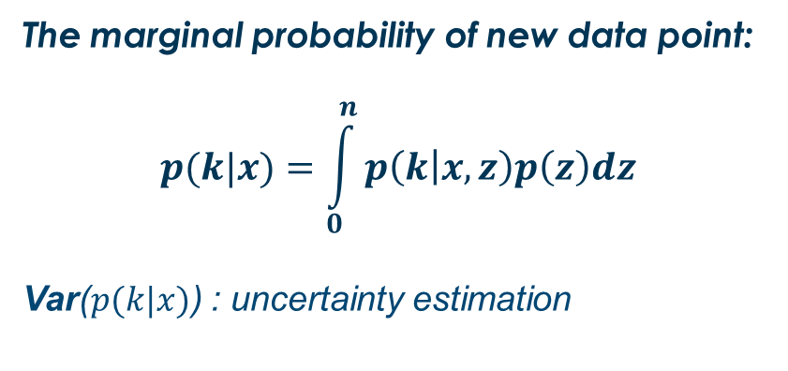
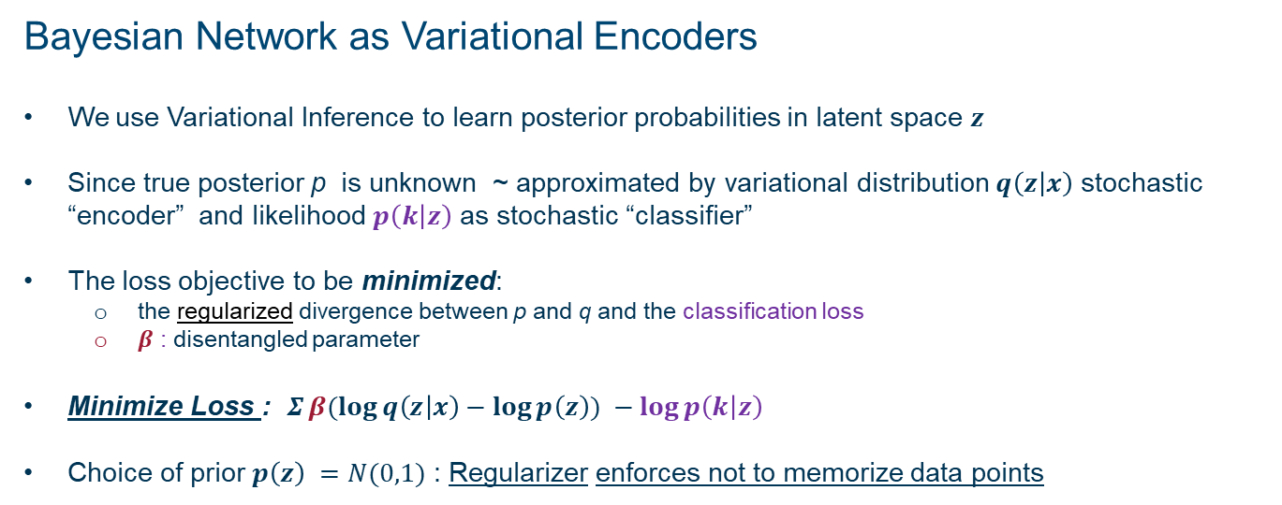
BAYSIAN NEURAL NETWORK AND LOSS FUNCTION
Bayesian Network as Variational Encoders
We use Variational Inference to learn posterior probabilities in latent space $z$
Since true posterior p is unknown ~ approximated by variational distribution $q\left(z | x\right)$ stochastic “encoder” and likelihood $p\left(k | z\right)$ as stochastic “classifier”
The loss objective to be minimized:
the regularized divergence between p and q and the classification loss
$β$ : disentangled parameter
Minimize Loss : $Σβ(log{q\left(z | x\right)}−\log{p\left(z\right)) −\log{p\left(k | z\right)}}$
Choice of prior $p\left(z\right) =N(0,1)$ : Regularizer enforces not to memorize data points
The marginal probability of new data point:
$$p(k|x)=\int_{0}^{n}{p\left(k | x,z\right)p\left(z\right)dz}$$
Var($p(k|x)$) : uncertainty estimation
z : latent variable
x : new data point
p(k) : predictive probability
of the class
n : sampled points
k : class

Slide 9
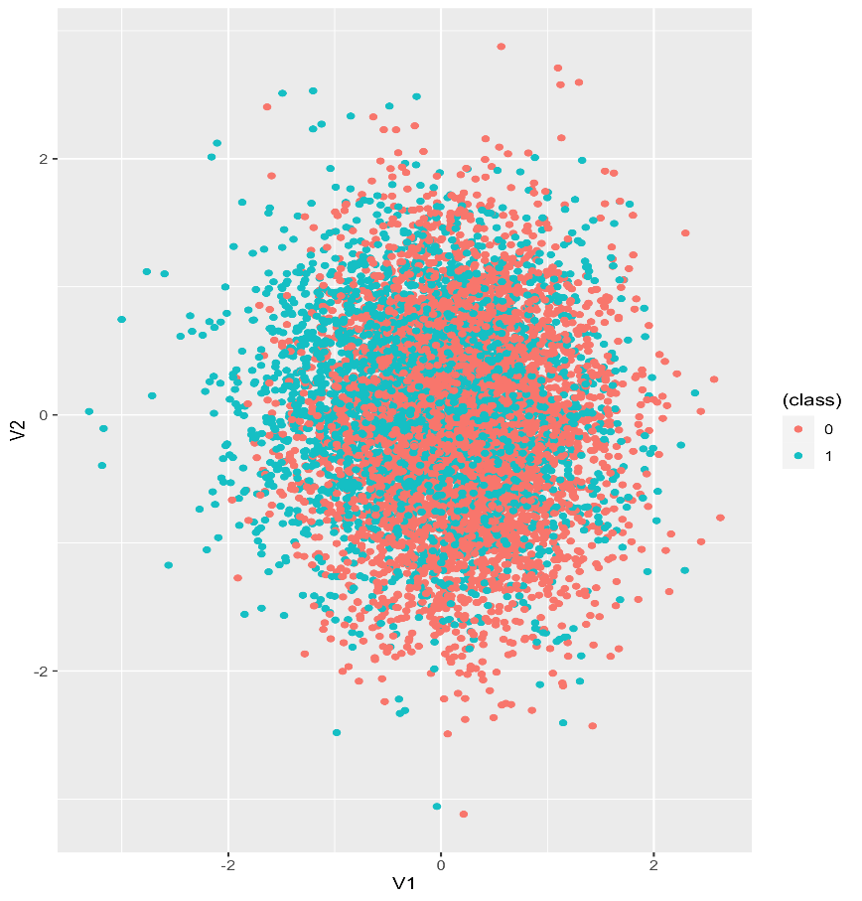
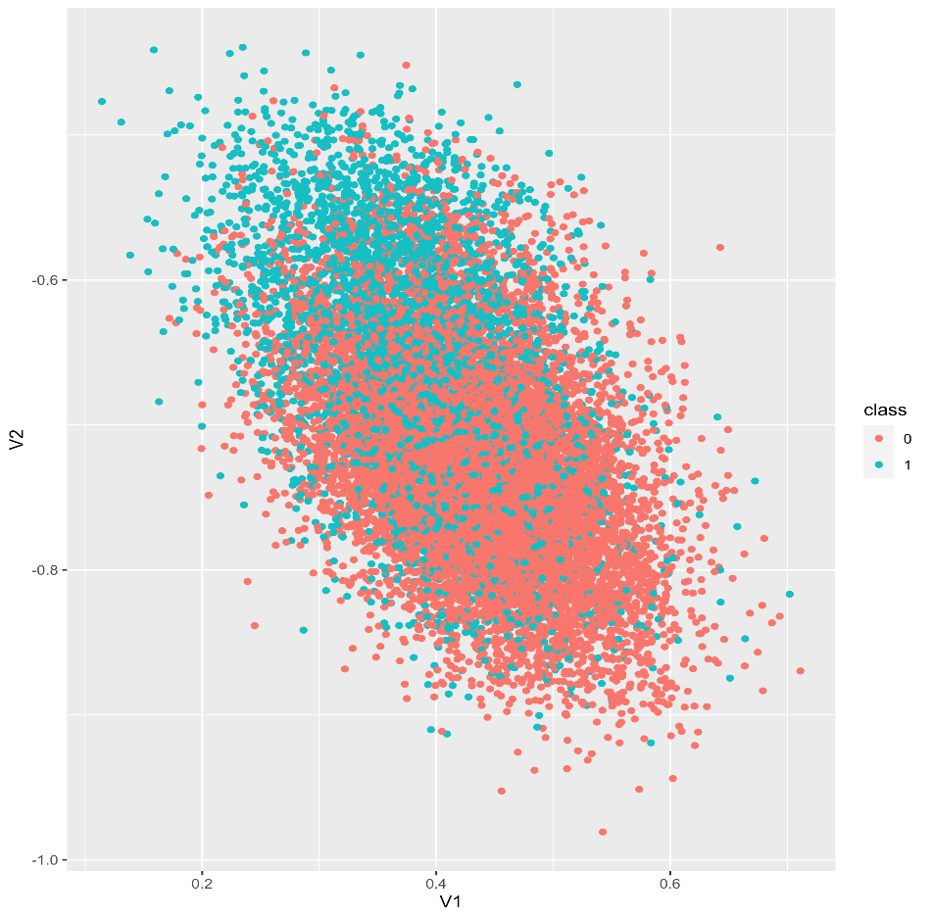
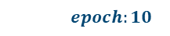
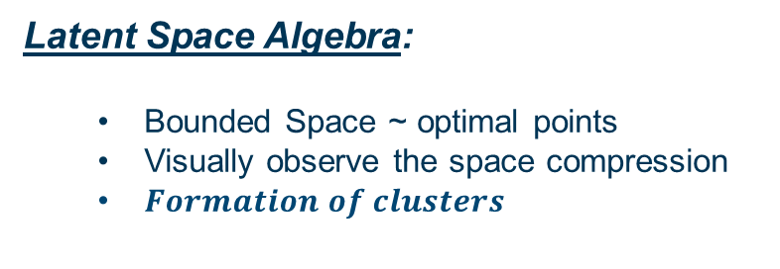
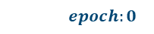

LATENT SPACE VECTORS ($β$=4, #of dimensions = 2 )
$Formation of clusters$
WO
$$epoch:0$$
$$epoch:10$$
PH
A
Latent Space Algebra:
Bounded Space ~ optimal points
Visually observe the space compression
$Formation of clusters$
PH-EM-PH
B
EM
ADV

Slide 10
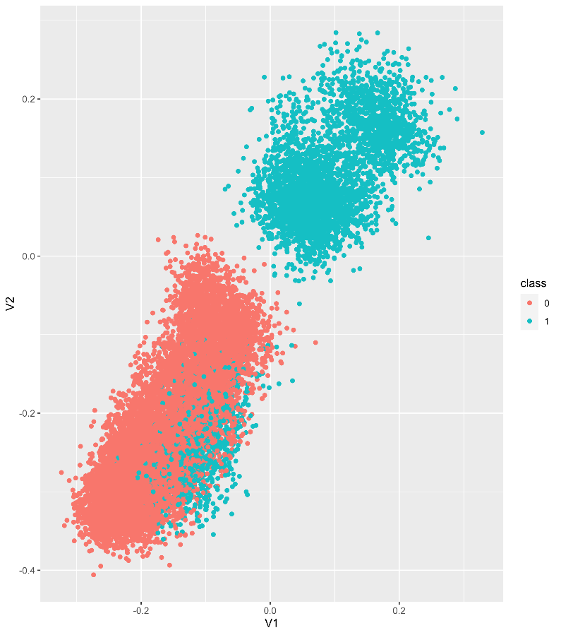
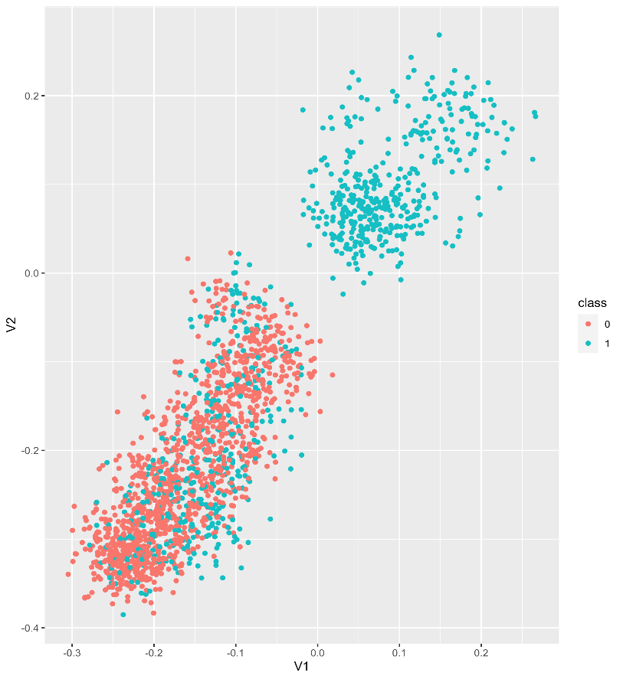



LATENT SPACE VECTORS ($β$=4, #of dimensions = 2 , Learnable Prior)
$Formation of clusters$
WO
$$epoch:10$$
$$Test Space$$
PH
A
Latent Space Algebra:
Bounded Space ~ optimal points
Visually observe the space compression
$Formation of clusters$
PH-EM-PH
B
EM
ADV

Slide 11
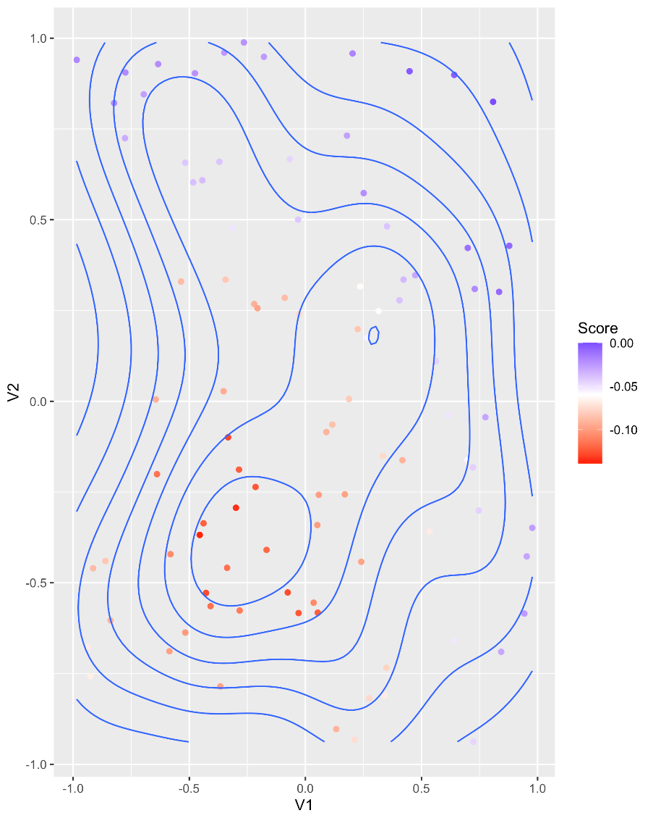
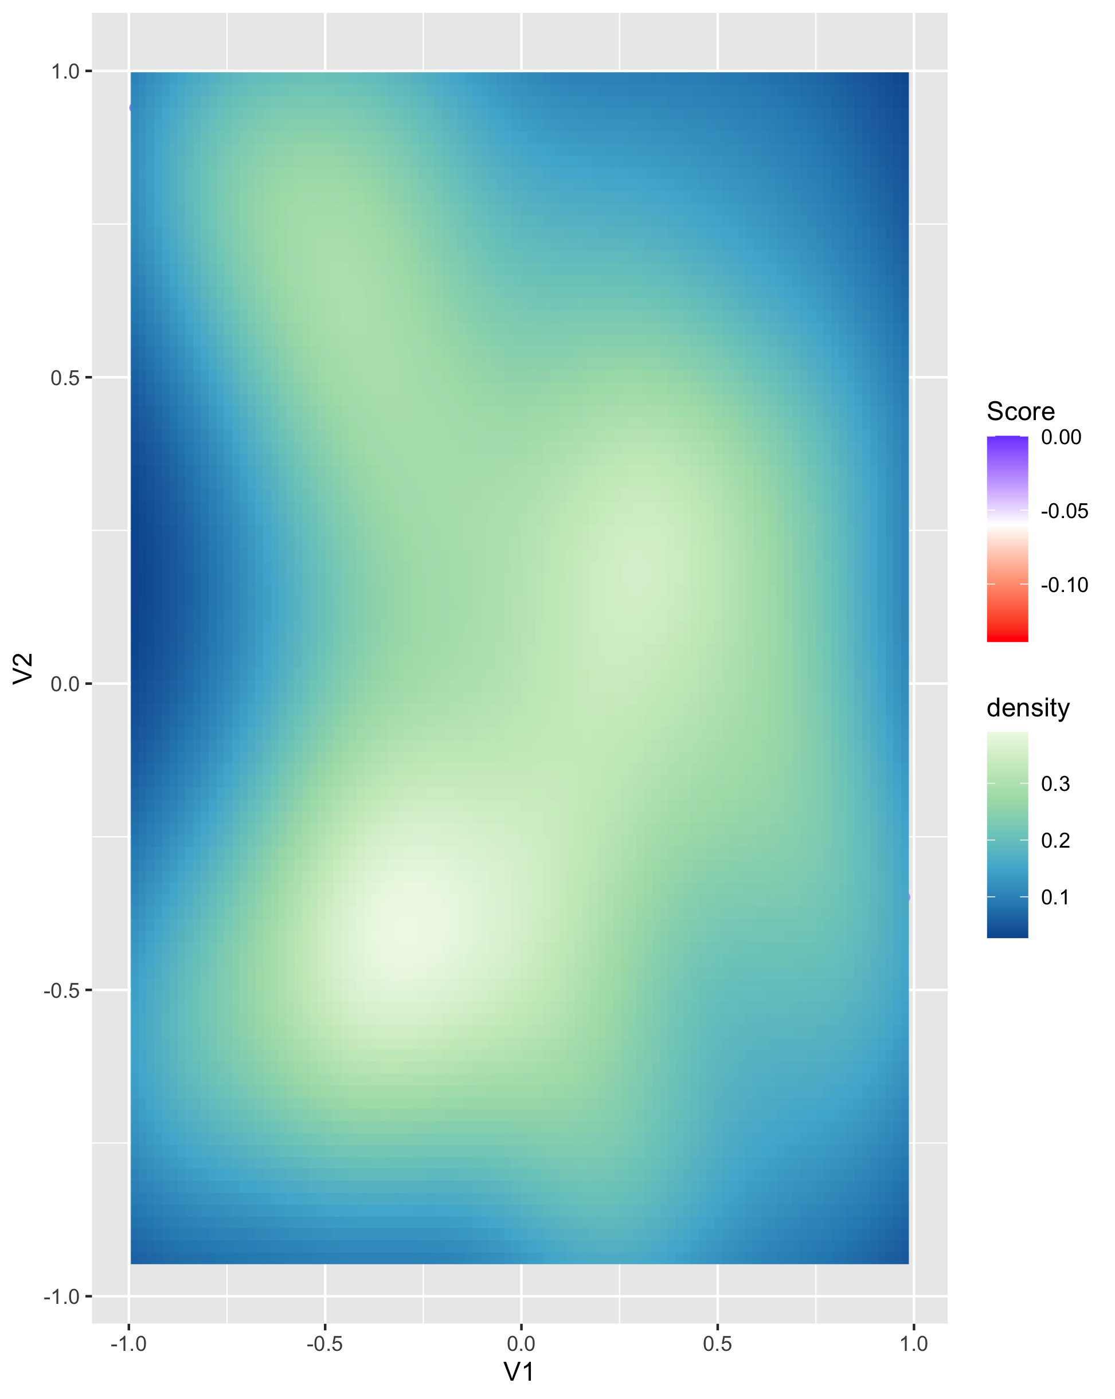
SPATIAL DENSITY (LATENT DIMENSIONS)

Slide 12
REGULARIZED MODEL
ADV – EM
1.00
Ch_1_1_2_1_6
Maintains consistency
over scores
ADV – EM – PHONE
1.25
Ch_1_1_2_5_6
ADV – EM – PHONE - EM
Ch_1_1_2_0_6
0.90

Slide 13
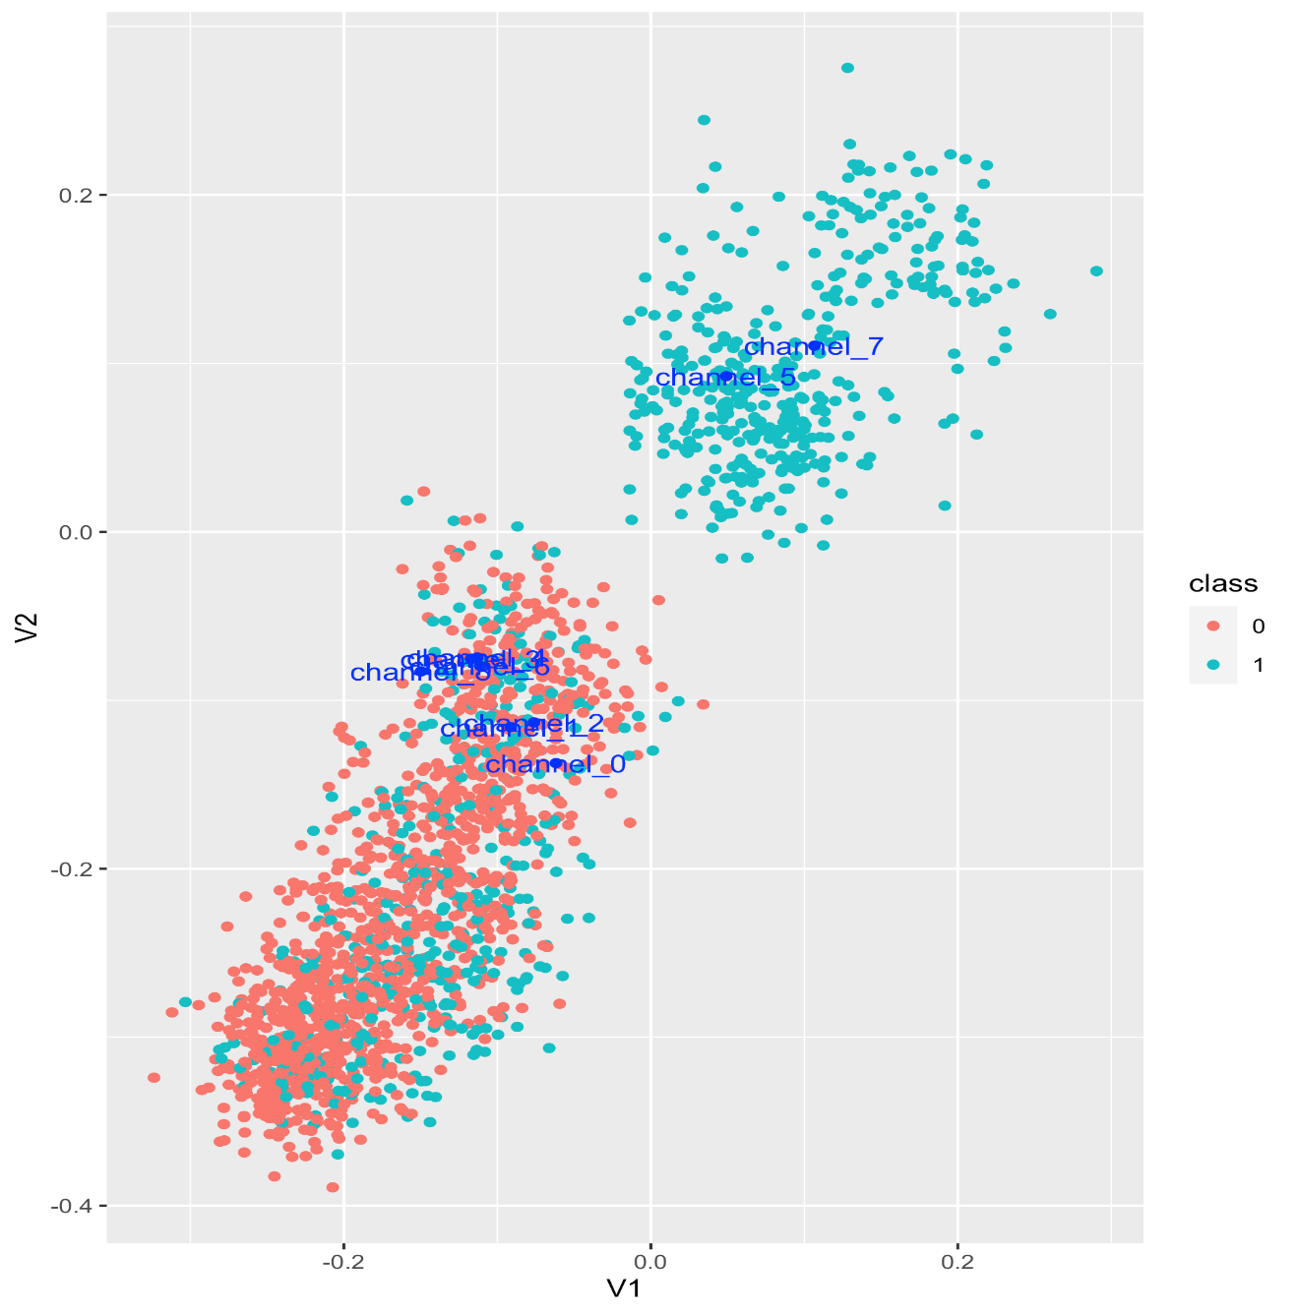
NEXT BEST ACTION ($β$=2, #of dimensions = 2 )
Optimize Actions:
‘Next Best Action’ –
most influential channel
Optimal sequence -
sequence of touches for maximum effect towards desired objective
* require optimization procedure
A

Slide 14
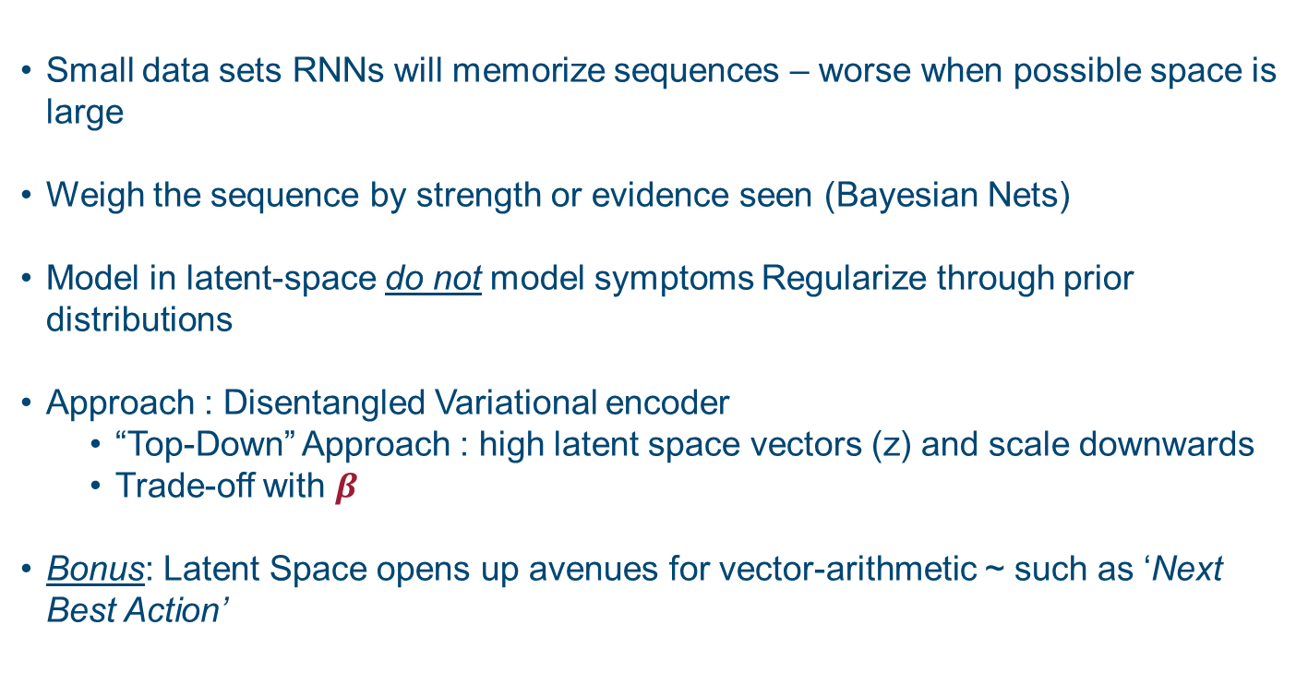
TAKE AWAYS
Small data sets RNNs will memorize sequences – worse when possible space is large
Weigh the sequence by strength or evidence seen (Bayesian Nets)
Model in latent-space do not model symptoms Regularize through prior distributions
Approach : Disentangled Variational encoder
“Top-Down” Approach : high latent space vectors (z) and scale downwards
Trade-off with $β$
Bonus: Latent Space opens up avenues for vector-arithmetic ~ such as ‘Next Best Action’

Slide 15
REFERENCES
Bayesian Neural Nets
https://arxiv.org/abs/1505.05424 [arxiv.org] -
InfoVAE: Information Maximizing Variational Autoencoders
https://arxiv.org/pdf/1706.02262.pdf
Understanding disentangling in β-VAE
https://arxiv.org/abs/1804.03599
Auto-Encoding Variational Bayes
https://arxiv.org/abs/1312.6114
http://papers.nips.cc/paper/7141-what-uncertainties-do-we-need-in-bayesian-deep-learning-for-computer-vision.pdf
ELBO Surgery
http://approximateinference.org/accepted/HoffmanJohnson2016.pdf
Code
https://github.com/vishalhawa/odsc

Slide 16

THANK YOU
“Lets stay curious… until robots take over”

Slide 17
APPENDIX

Slide 18
UNCERTAINITY ESTIMATES
ADV : mean 0.25 , var = 20%
ADV – EM : mean 0.4 var = 15%
ADV – EM – PHONE : mean 0.25 var = 10%
ADV – EM – PHONE – EM: mean 0.3 var = 5%

Slide 19
BAYESIAN INFERENCE QUERIES
Inference on Bayesian networks consists of conditional probability (CPQ) given some evidence (Marginal)
Maximum a posteriori (MAP) queries {finding configuration q* of variables/nodes that has highest posterior probability}
Path: ADV/DM-PH-PAS
Rescue: Regularize through PGMs
Make use of conditional probabilities ~ BNs
Solution: for each ‘path’ calculate probabilistic estimates
ADV
DM
Web
PH
Client Y/N
CPQ: P(Client =Y |Web=0)

